Slide 1
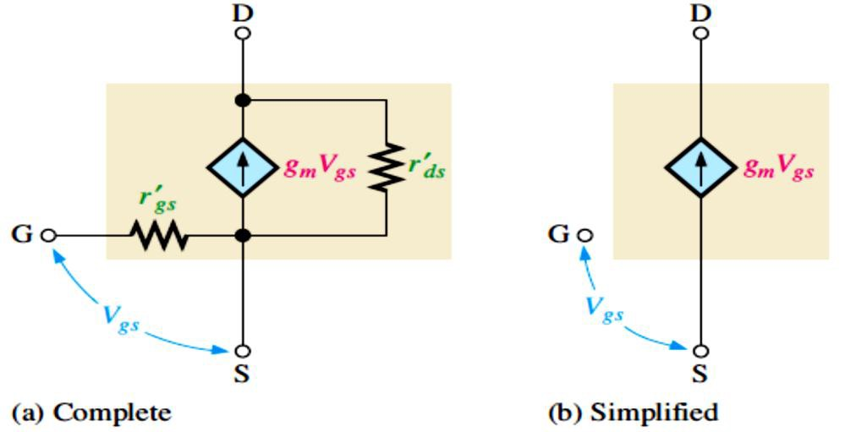
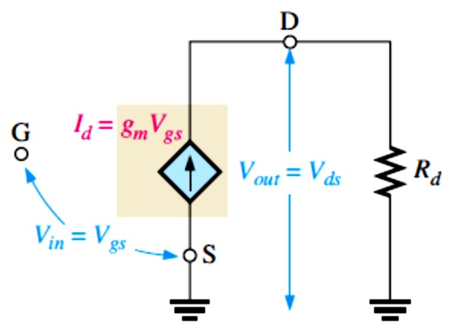
Lecture 9: FET Amplifiers and Switching Circuits
Because of their extremely high input resistance and low noise compared to the BJT,
  FET amplifiers are a good choice for certain applications, such as amplifying low-level signals in the first stage of a communication receiver. Disadvantages, however, include
higher distortion and lower gain.
FETs also have the advantage in certain power amplifiers and in switching circuits
  because biasing is simple and more efficient.
The standard amplifier configurations are common-source (CS), common-drain (CD) and common-base (CB), which are analogous to CE, CC, and CB configurations of BJTs.
FETs can be used in any of the amplifier types introduced earlier(class A,class B,and class C).
Another type of amplifier (class D) is introduced in this chapter because FETs are always superior to BJTs in class D amplifier.
The class D amplifier is a switching amplifier that is normally either in cutoff or saturation.
  It is used in analog power amplifiers with a circuit called a pulse-width modulator.
9.1 The Common-Source Amplifier
FET AC Model: An equivalent FET model is shown in Figure 9-1. �_{g�}´ is assumed to be extremely large so that is assumed an open circuit between the G and S. Also, ���´ is assumed large enough to neglect.
The transconductance, g�, of a FET relates the output current, 𝐼� , to the input voltage, �_{g�}
FIGURE 9-1: Internal FET equivalent circuits.
An ideal FET circuit model with an external ac drain resistance is shown in Figure 9-2. The ac voltage gain expression of this circuit is , therefore,
𝑨� = ��𝑹�
Equation 9– 1
FIGURE 9-2: Simplified FET equivalent circuit with an external ac drain resistance.

Slide 2
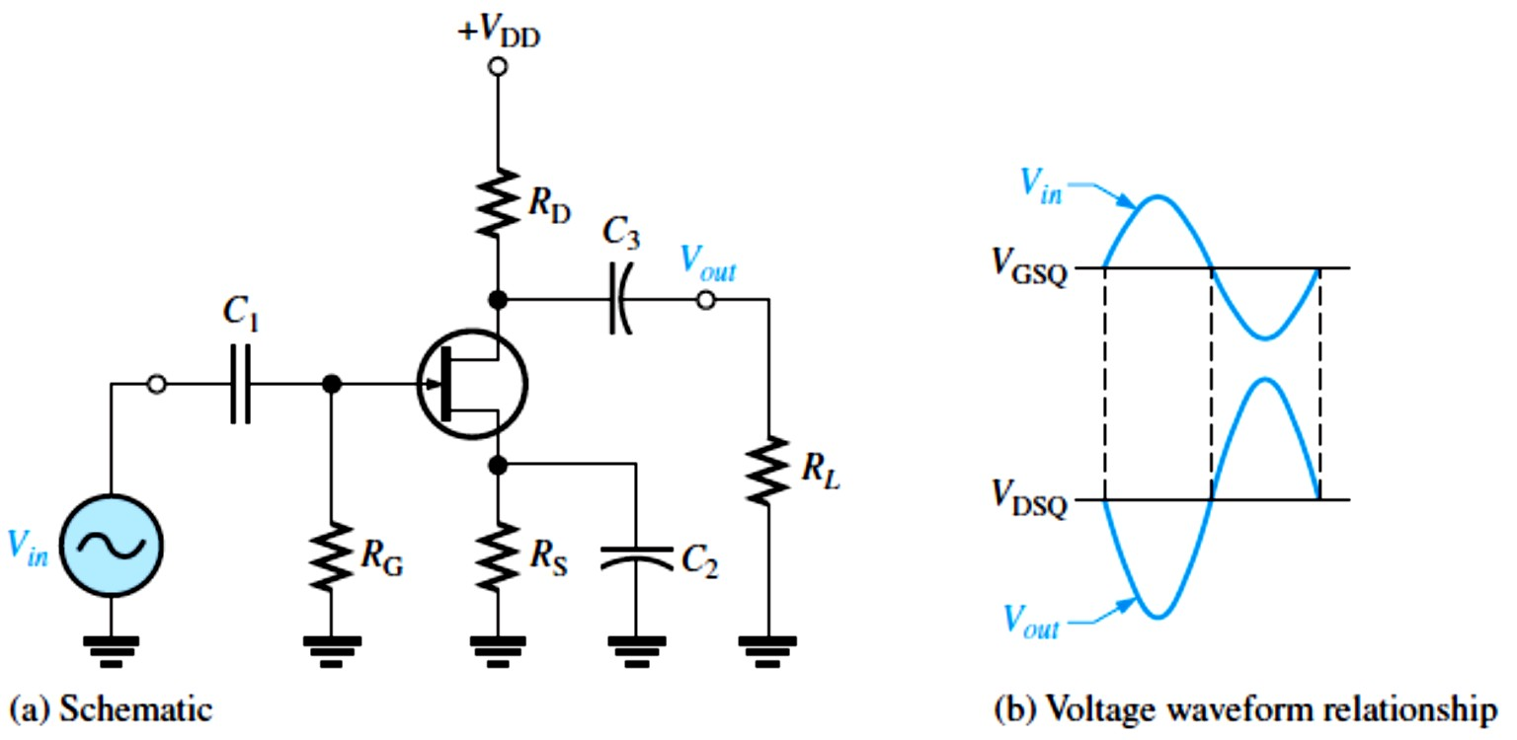
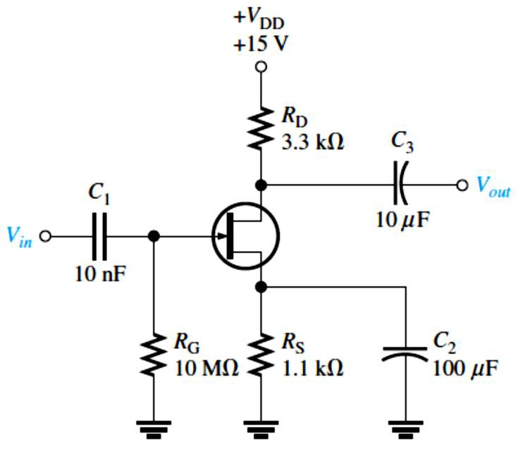
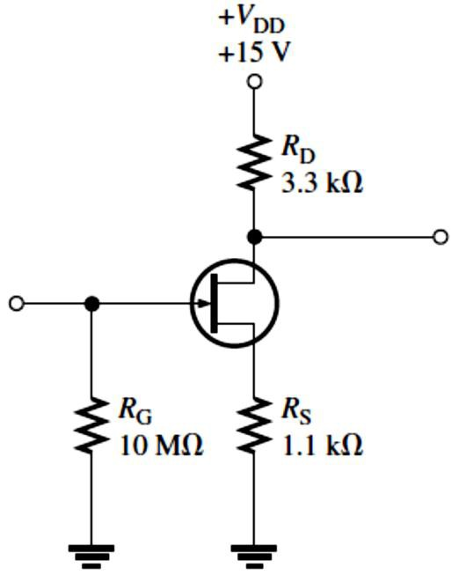
EXAMPLE 9-1: A certain JFET has a g� = 4 mS. With an external ac drain resistance of
1.5 kΩ. What is the ideal voltage gain?
Solution 𝐴� = g��� = (4 mS)(1.5 kΩ) = 6
JFET Amplifier Operation: A CS JFET amplifier is one in which the ac input signal is applied to the gate and the ac output signal is taken from the drain.
A self-biased CS n-channel JFET amplifier with an ac source capacitively coupled to the gate is shown in Figure 9-3.
FIGURE 9-3: JFET
common-source amplifier.
DC Analysis: The first step in analyzing a JFET amplifier is to determine the dc conditions
𝐼_{D} and �_{S}.
  𝐼_{D} determines the Q-point for an amplifier and enables us to calculate �_{D}.
The amplifier shown in Figure 9-4 and 9-5 will be used to to determine 𝐼_{D} and �_{S}.
�
𝑰� = 𝑰_{�𝐒𝐒}(� − _{𝑽}
𝑰�𝑹_{𝐒}
) Equation 9– 2
𝐆�(���)
FIGURE 9-4: JFET common-source amplifier.
FIGURE 9-5: DC equivalent for the amplifier in Figure 9-4.

Slide 3
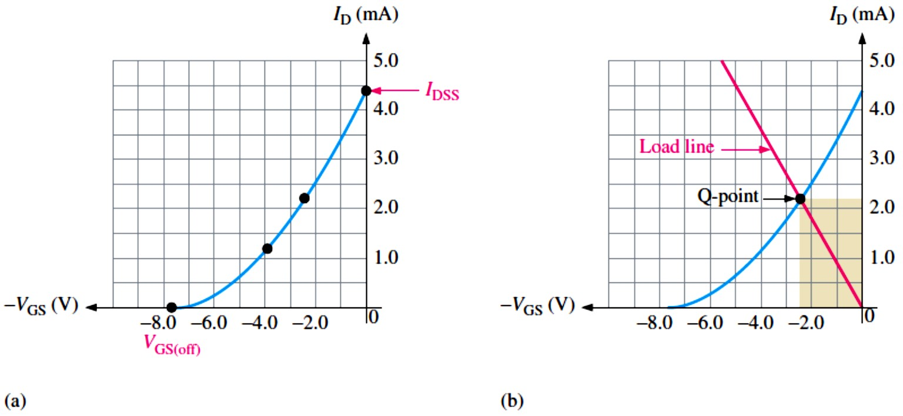
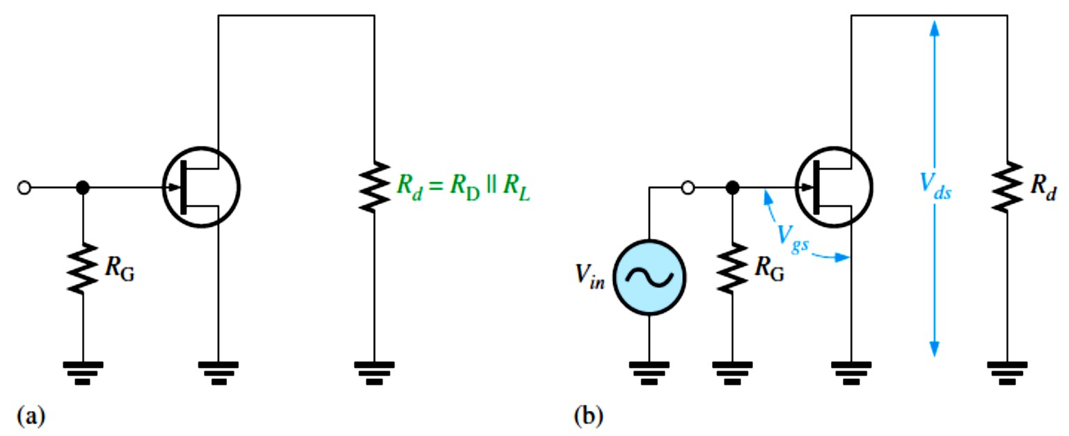
EXAMPLE 9-2: Determine 𝐼_{D} and �_{GS} at the Q-point for the JFET amplifier in Figure 9-5. The typical 𝐼_{DSS} for this particular JFET is 4.3 mA and �_{GS(off)} is −7.7 V.
Solution We plot the transconductance curve. The end points are at 𝐼_{DSS} and �_{GS(off)}. We can plot two additional points quickly by noting from the universal curve in Figure 8-7, that
�_{GS} = 0.3 �_{GS(off)} = 0.3(−7.7 V) = −2.31 V when 𝐼_{D} = 𝐼_{DSS}⁄2 = 4.3 mA⁄2 = 2.15 mA
And �_{GS} = 0.5 �_{GS(off)} = 0.5(−7.7 V) = −3.85 V when 𝐼_{D} = 𝐼_{DSS}⁄4 = 4.3 mA⁄4 = 1.075 mA For this particular JFET, the points are plotted as shown in Figure 9-6(a). Recall from Lcture 8 that the load line starts at the origin and goes to a point where 𝐼_{D} = 𝐼_{DSS} and �_{GS} = 𝐼_{DSS}�_{S}. We add the load line to the graph and read the 𝐼_{D} and �_{GS} values from the intersection (Q-point), as shown in Figure 9-6(b). For the graph shown, 𝑰� = �. � ��and 𝑽_{𝐆�}= −�. 𝟒𝐕.
FIGURE 9-6.
AC Equivalent Circuit: To analyze the signal operation of the amplifier in Figure 9-4, we develop an ac equivalent circuit as shown in Figure 9-7.
  The voltage gain of a CS amplifier is determined by g� and the drain resistance, ��.
𝑨� = ��𝑹�
where �� = �_{D} ∥ �_{𝐿}.
Equation 9– 3
FIGURE 9-7:
AC equivalent for the amplifier in Figure 9-4.

Slide 4
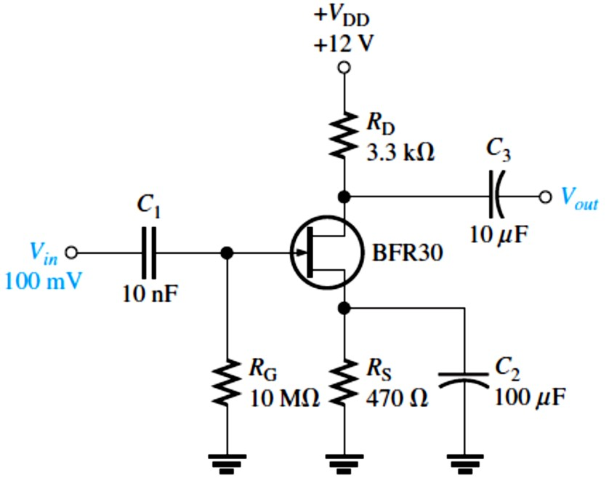
EXAMPLE 9-4: What is the total output voltage for the unloaded amplifier in Figure 9-8? 𝐼_{DSS}
is 4.3 mA; �_{GS(off)} is −2.7 V.
FIGURE 9-8
Solution We use either a graphical approach,
as shown in Example 9–2, or a mathematical approach with a graphing calculator, to determine
𝐼_{D}. The calculator solution gives 𝐼_{D} = 1.91 mA. Using this value, we calculate �_{D}.
�_{D} = �_{DD} − 𝐼_{D}�_{D}
�_{D} = 12 V − (1.91 mA)(3.3 kΩ) = 5.70 V
Next we calculate g� as follows:
�_{GS} = �_{G} − �_{S} = 0 − 𝐼_{D}�_{S} = −𝐼_{D}�_{S}
�_{GS} = −(1.91 mA)(470 Ω) = −0.90 V
g_{�0} = 2𝐼_{DSS}⁄|�_{GS(off)}| = 2(4.3 mA)⁄|−2.7 V| = 8.6 mA⁄2.7 V = 3.18 mS
g� = g_{�0}(1 − (�_{GS}⁄�_{GS(off)})) = 3.18 mS(1 − (−0.90 V⁄−2.7 V)) = 2.12 mS
Finally, we find the ac output voltage. �� = �_{D}
���� = ��� = 𝐴��_{𝑖�} = g��� �_{𝑖�} = g��_{D}�_{𝑖�} = (2.12 mS)(3.3 kΩ)(100 mV) = 700 mV
Effect of an AC Load on Voltage Gain: A load resistance �_{𝐿}connected to the drain of CS amplifier reduces the voltage gain.
�� = �_{D} ∥ �_{𝐿}= (�_{D}�_{𝐿})⁄(�_{D} + �_{𝐿})
EXAMPLE 9-5: If a 4.7 kΩ load resistor is ac coupled to the output of the amplifier in Example 9-4, what is the resulting rms output voltage?
Solution The ac drain resistance is
�� = �_{D} ∥ �_{𝐿}= (�_{D}�_{𝐿})⁄(�_{D} + �_{𝐿}) = (3.3 kΩ)(4.7 kΩ)⁄(3.3 kΩ + 4.7 kΩ) = 1.94 kΩ
���� = 𝐴��_{𝑖�} = g��� �_{𝑖�} = (2.12 mS)(1.94 kΩ)(100 mV) = 411 mV rms
The unloaded ac output voltage was 700 mV in Example 9-4.
Phase Inversion: There is a 180° phase inversion between gate and drain voltages.
Input Resistance: Because the input to a CS amplifier is at the gate, the input resistance is extremely high. Ideally, it approaches infinity and can be neglected.
The high input resistance is produced by the reverse-biased pn junction in a JFET and by the insulated gate structure in a MOSFET.
^{𝑹}𝒊� ^{= 𝑹}𝐆^{∥ 𝑹}𝐈�(�𝐚��) ^{= 𝑹}𝐆^{∥ (𝑽}𝐆�^{⁄𝑰}𝐆𝐒�⁾
Equation 9– 4
Since the term �_{IN(gate)} = �_{GS}⁄𝐼_{GSS} ≫ �_{G}, the �_{IN(gate)} is very close to the value of �_{G}.

Slide 5
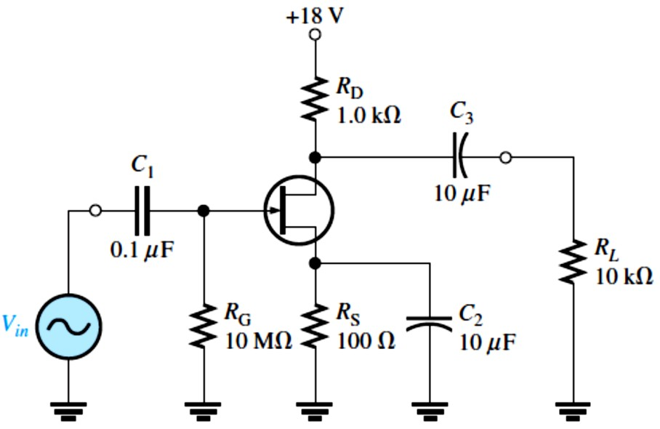
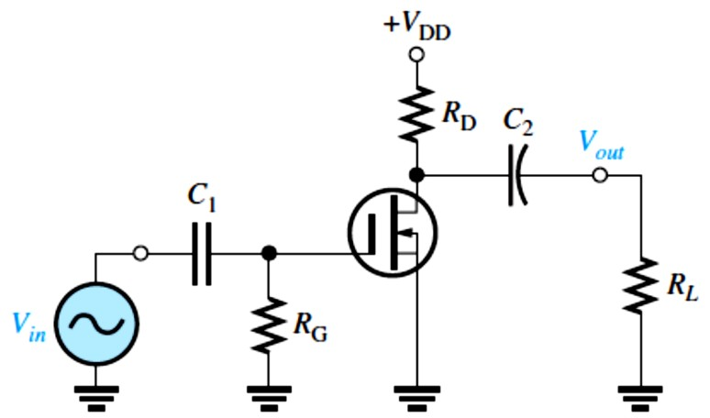
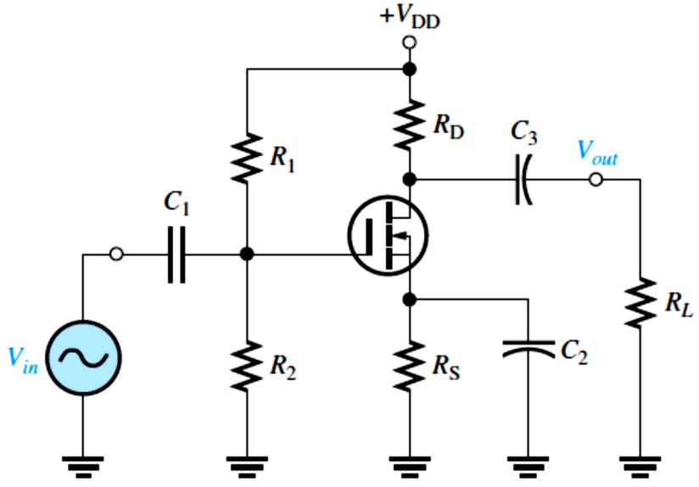
EXAMPLE 9-6: What input resistance is seen by the signal source in Figure 9-9? 𝐼_{GSS} = 30 nA
at �_{GS} = 10 V.
FIGURE 9-9
Solution The input resistance at the gate of the JFET is
�IN(gate) ⁼ _{𝐼}
�GS
10 V
= _{30 nA} = 333 MΩ
GSS
The input resistance seen by the signal source is
�𝑖� ^{= �}G ∥ �IN(gate)
�_{𝑖�} = 10 MΩ ∥ 333 MΩ = 9.7 MΩ
For all practical purposes, �_{IN} can be assumed equal to �_{G}.
D-MOSFET Amplifier Operation: A zero-biased CS n-channel D-MOSFET with an ac source capacitively coupled to the gate is shown in Figure 9-10.
Gate is at approximately 0 V dc and the source terminal is at ground, thus making �_{GS} = 0 V.
^{𝑰}� ^{= 𝑰}�𝐒𝐒
𝑨� = ��𝑹�
^{𝑽}𝐆�
𝑹_{𝒊�} = 𝑹_{𝐆}∥ (_{𝑰})
𝐆𝐒�
FIGURE 9-10: Zero-biased D-MOSFET CS amplifier.
E-MOSFET Amplifier Operation: A CS n-channel E-MOSFET with voltage-divider bias with an ac source capacitively coupled to the gate is shown in Figure 9-11.
The gate is biased with a positive voltage such that �_{GS} > �_{GS(th)}.
^{𝑰}� ^{= �(𝑽}𝐆�^{− 𝑽}𝐆�(��)⁾
𝑨� = ��𝑹�
�
^{𝑹}𝒊� ^{= 𝑹}� ^{∥ 𝑹}� ^{∥ 𝑹}𝐈�(�𝐚��)
𝑹_{𝒊�} = 𝑹� ∥ 𝑹� ∥ (𝑽_{𝐆�}⁄𝑰_{𝐆𝐒�})
Equation 9– 5
FIGURE 9-11: CS E-MOSFET
amplifier with voltage-divider bias.

Slide 6
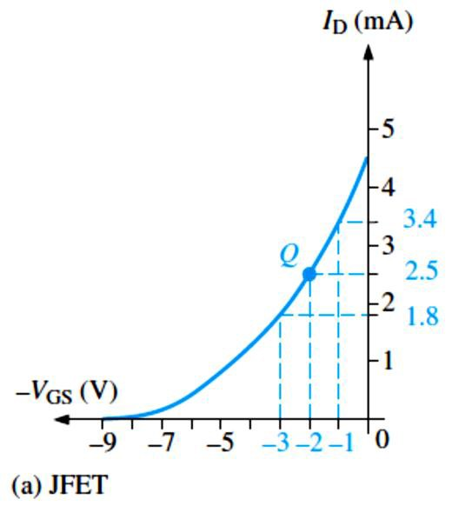
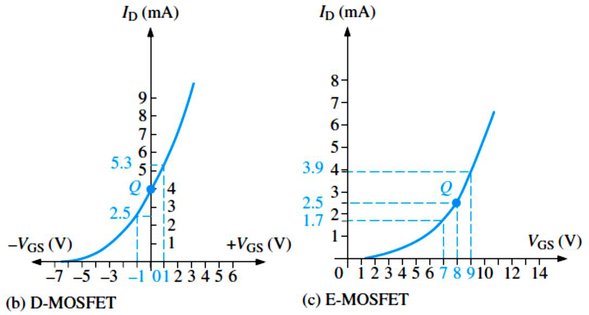
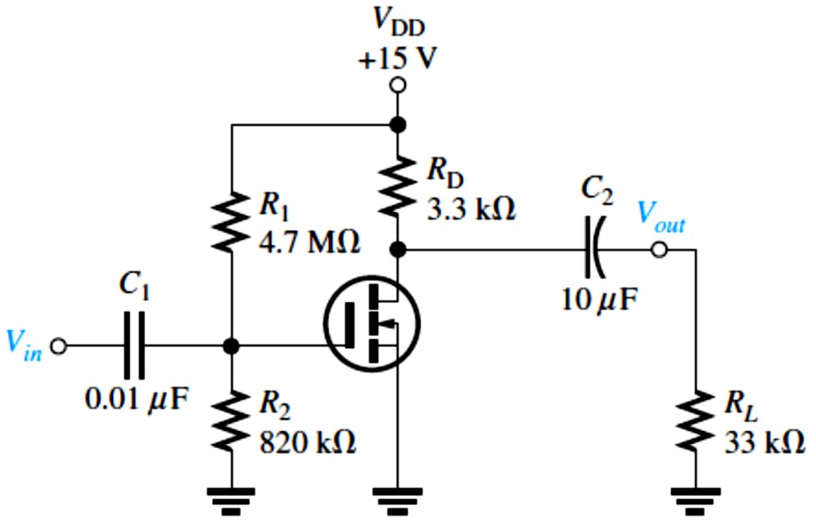
EXAMPLE 9-7: Transfer characteristic curves for a particular n-channel JFET, D-MOSFET, and E-MOSFET are shown in Figure 9-12. Determine the peak-to-peak variation in 𝐼� when �_{g�} is varied ±1 V about its Q-point value for each curve.
FIGURE 9-12
Solution (a) The JFET Q-point is at �_{GS} = −2 V and 𝐼_{D} = 2.5 mA. From the graph in Figure 9-12(a),
𝐼_{D} = 3.4 mA when �_{GS} = −1 V, and 𝐼_{D} = 1.8 mA when �_{GS} = −3 V. The peak-to-peak drain current is therefore 3.4 mA − 1.8 mA = 1.6 mA.
The D-MOSFET Q-point is at �_{GS} = 0 V and 𝐼_{D} = 𝐼_{DSS} = 4 mA. From the graph in Figure 9- 12(b), 𝐼_{D} = 2.5 mA when �_{GS} = −1 V, and 𝐼_{D} = 5.3 mA when �_{GS} = +1 V. The peak-to-peak drain current is therefore 5.3 mA − 2.5 mA = 2.8 mA.
The E-MOSFET Q-point is at �_{GS} = +8 V and 𝐼_{D} = 2.5 mA. From the graph in Figure 9-12(c),
𝐼_{D} = 3.9 mA when �_{GS} = +9 V, and 𝐼_{D} = 1.7 mA when �_{GS} = +7 V. The peak-to-peak drain current is therefore 3.9 mA − 1.7 mA = 2.2 mA.
EXAMPLE 9-8: A common-source amplifier using an E-MOSFET is shown in Figure 9-13. Find �_{GS}, 𝐼_{D}, �_{DS}, and the ac output voltage. Assume that for this particular device, 𝐼_{D(on)} = 200 mA at �_{GS} = 4 V, �_{GS(th)} = 2 V, and g� = 23 mS. �_{𝑖�} = 25 mV.
FIGURE 9-13
Solution
�_{GS} = (�₂⁄(�₁ + �₂))�_{DD}
�_{GS} = (820 kΩ⁄(4.7 MΩ + 820 kΩ))15 V
�_{GS} = 2.23 V
For �_{GS} = 4 V,
^{� = 𝐼}D(on)^{⁄(�}GS ^{− �}GS(th)⁾
2
200 mA
� = _{(4 V − 2 V)2} = 50 mA⁄V
2
Therefore, 𝐼_{D} = �(�_{GS} − �_{GS(th)})
2

Slide 7
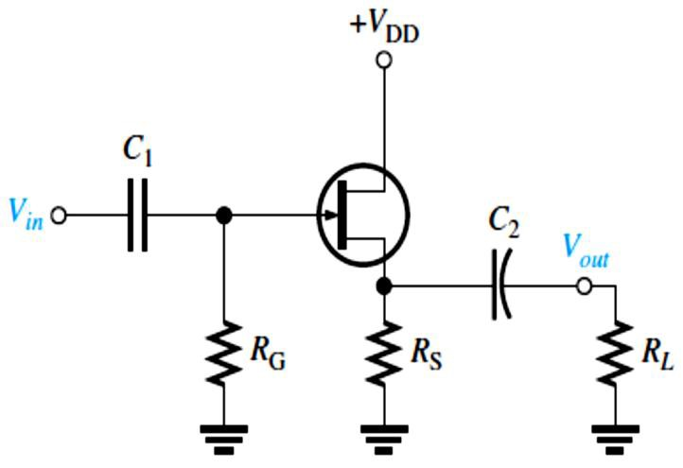
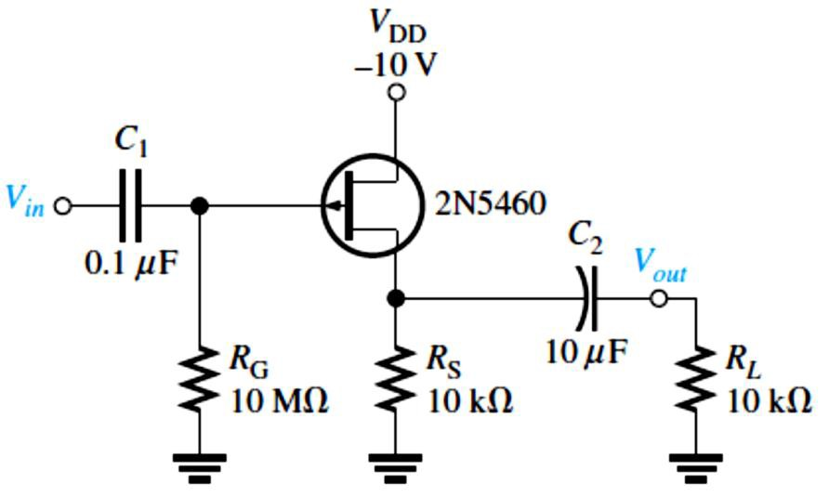
𝐼_{D} = (50 mA⁄V²)(2.23 V − 2 V)² = 2.65 mA
�_{DS} = �_{DD} − 𝐼_{D}�_{D} = 15 V − (2.65 mA)(3.3 kΩ) = 6.26 V
�� = �_{D} ∥ �_{𝐿}= (�_{D}�_{𝐿})⁄(�_{D} + �_{𝐿}) = (3.3 kΩ)(33 kΩ)⁄3.3 kΩ + 33 kΩ = 3 kΩ
The ac output voltage is ���� = 𝐴��_{𝑖�} = g��� �_{𝑖�} = (23 mS)(3 kΩ)(25 mV) = 1.73 mV
9.2 The Common-Drain Amplifier
A CD JFET amplifier, shown in Figure 9-14, is also called a source-follower. Self-biasing is used in this particular circuit.
^{𝑰}� ^{= 𝑰}�𝐒𝐒^{(� − (𝑰}�^{𝑹}𝐒^{⁄𝑽}𝐆�(���)⁾⁾
�
The voltage gain of a CD amplifier (source-follower) is always slightly less than 1.
𝑨� = ��𝑹�⁄(� + ��𝑹�)
^{𝑹}𝒊� ^{= 𝑹}𝐆^{∥ 𝑹}𝐈�(�𝐚��)
Equation 9– 6
Equation 9– 7
^{where 𝑹}𝐈�(�𝐚��) ^{=𝑽}𝐆�^{⁄𝑰}𝐆𝐒�.
FIGURE 9-14: JFET common-drain amplifier (source-follower).
There is no phase inversion between gate and source in a source-follower.
EXAMPLE 9-9: Determine the voltage gain of the amplifier in Figure 9-15 using the datasheet information in Figure 9-16. Also, determine the input resistance. Use minimum datasheet values where available. �_{DD} is negative because it is a p-channel device.
Solution Since �_{𝐿}≫ �_{S}, �� ≅ �_{S} = 10 kΩ. From the partial datasheet in Figure 9–21, g� = ��� = 1000 𝜇S(minimum).
The voltage gain is
g���
FIGURE 9-15
^{𝐴� =} 1 + g �
� �
(1000 𝜇S)(10 kΩ)
^{𝐴� =} 1 + (1000 𝜇S)(10 kΩ) ^{= 0.909}
From the datasheet,
𝐼_{GSS} = 5 nA (maximum) at �_{GS} = 20 V. Therefore,
�IN(gate) ⁼ _{𝐼}
�GS
20 V
= = 4000 MΩ
5 nA
�IN
= �_{G}
GSS
= 10 MΩ ∥ 4000 MΩ ≅ 10 MΩ
∥ �IN(gate)

Slide 8
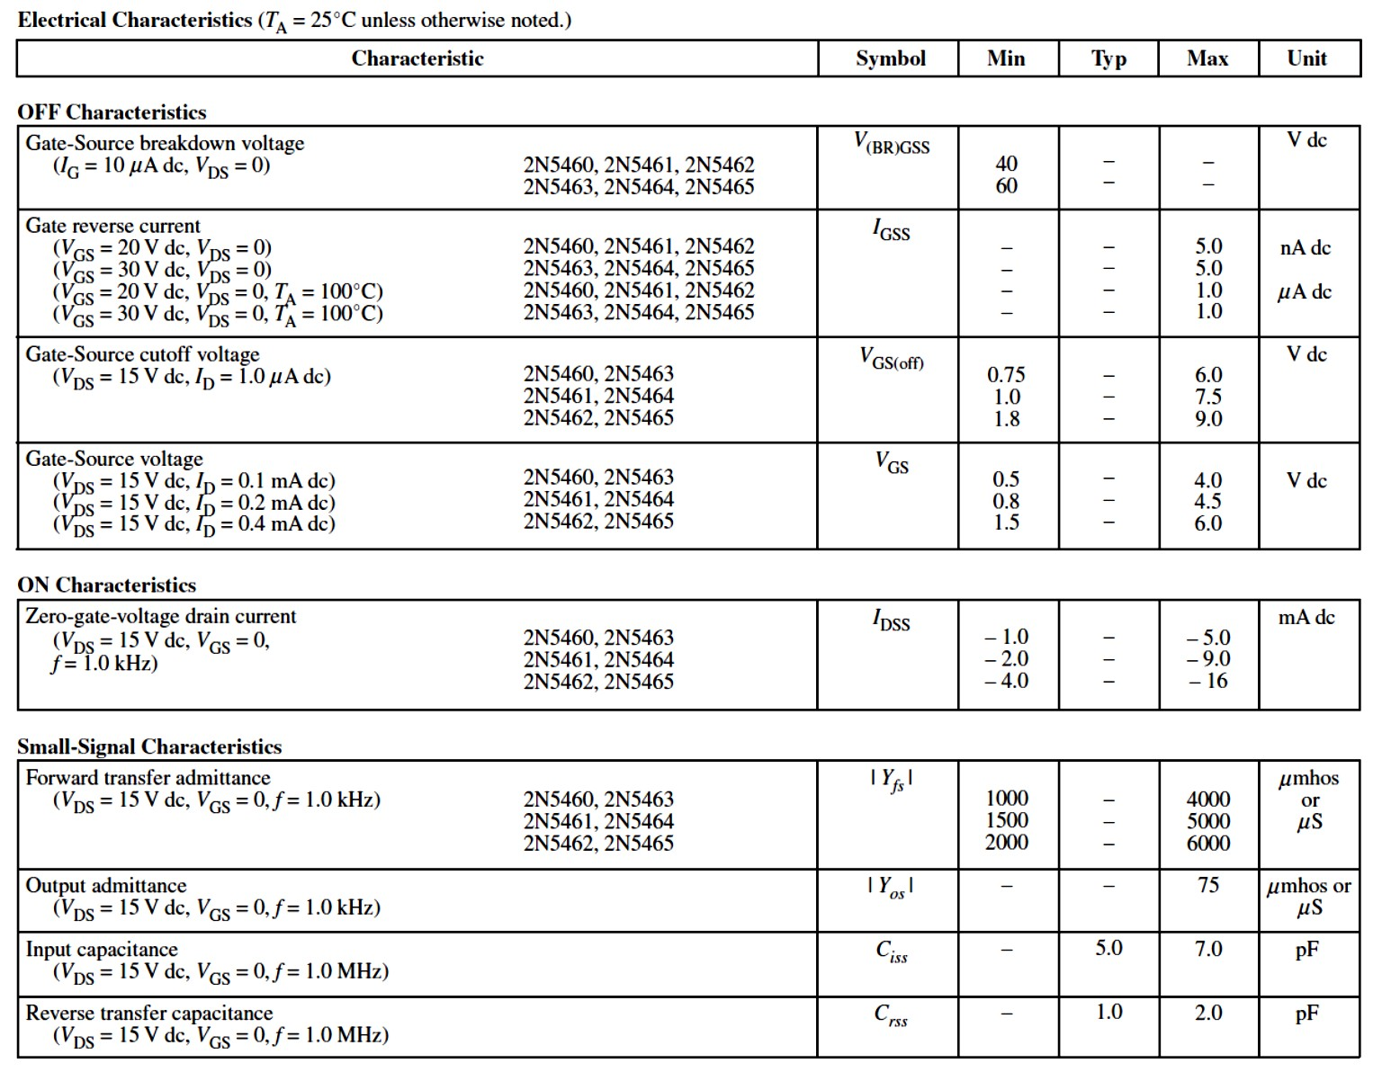
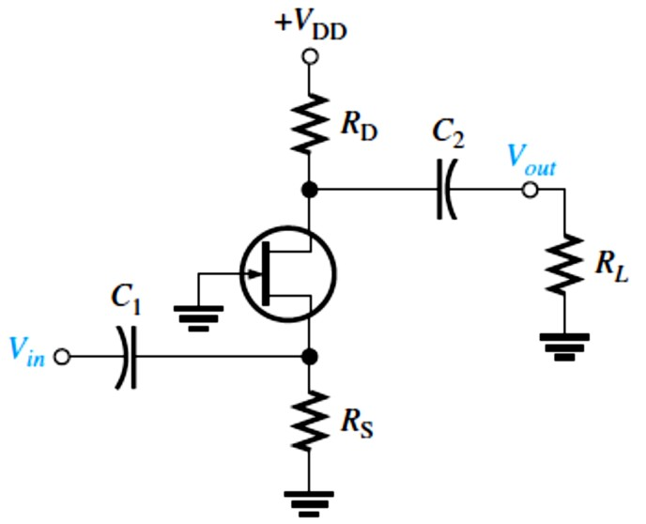
FIGURE 9-16: Partial datasheet for the 2N5460-2N5465 p-channel JFETs.
9.3 The Common-Gate Amplifier
A self-biased CG amplifier, shown in Figure 9-17, has a low input resistance.
^{𝑰}� ^{= 𝑰}�𝐒𝐒^{(� − (𝑰}�^{𝑹}𝐒^{⁄𝑽}𝐆�(���)⁾⁾
�
𝑨� = ��𝑹�
where �� = �_{D} ∥ �_{𝐿}.
Equation 9– 8
The input resistance of a CG amplifier is the reciprocal of g�.
^{𝑹}𝒊� ^{= 𝑹}𝒊�(������) ^{∥ 𝑹}𝐒^{= (�⁄�}�^{) ∥ 𝑹}𝐒
^{𝑹}𝒊�(������) ^{= �⁄�}�
Equation 9– 9
FIGURE 9-17: JFET common-gate amplifier.

Slide 9
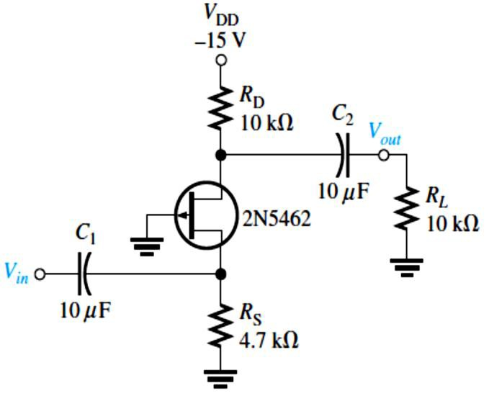
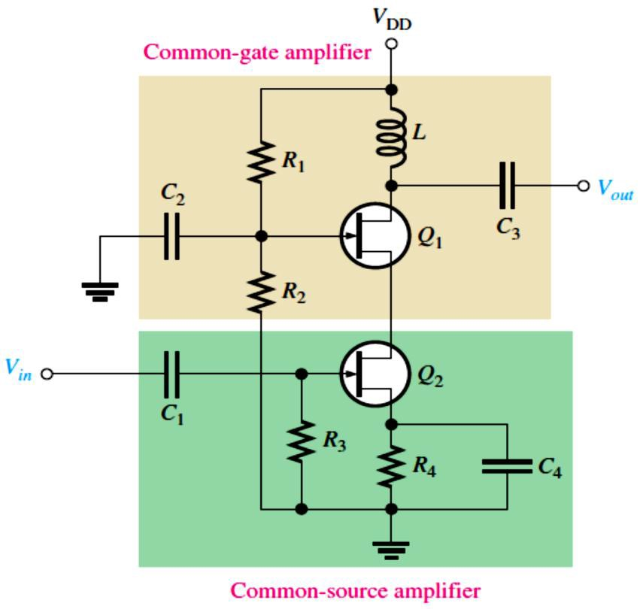
EXAMPLE 9-10: Determine the minimum voltage gain and input resistance of the amplifier in Figure 9-18. �_{DD} is negative because it is a p-channel device.
FIGURE 9-18
Solution From the datasheet in Figure 9–21, g� = 2000 𝜇S minimum. This CG amplifier has a load resistor, so the effective drain resistance is �� = �_{D} ∥ �_{𝐿}and the minimum voltage gain is
𝐴� = g��� = g�(�_{D} ∥ �_{𝐿})
𝐴� = (2000 𝜇S )(10 kΩ ∥ 10 kΩ) = 10
The input resistance at the source terminal is
�𝑖�(������) ⁼ _{g}
1
1
= = 500 Ω 2000 𝜇S
�
The signal source actually sees �_{S} in parallel with �_{𝑖�(������)}, so the total input resistance is
�_{𝑖�} = �_{𝑖�(������)} ∥ �_{S} = 500 Ω ∥ 4.7 kΩ = 452 Ω
The Cascode Amplifier: is one in which a a CS amplifier and a CG amplifier are connected in a series arrangement and it is commonly used for RF (radio frequency) applications.
A JFET cascode amplifier circuit is shown in Figure 9-19. The input stage is a CS amplifier, and its load is a CG amplifier connected in the drain circuit.
The voltage gain of the cascode amplifier provided by the CG amplifier. 𝑨� ≅ �_{�(��)}𝑿�
where 𝑋_{𝐿}is the reactance of the inductor in the drain of the CG stage.
The input resistance to the cascade amplifier is �_{𝑖�} = �₃ ∥ (�_{GS}⁄𝐼_{GSS})
FIGURE 9-19: A JFET cascode amplifier.
EXAMPLE 9-11: For the cascode amplifier in Figure 9-19, the transistors are 2N5485s and have a minimum
g� (g��) of 3500μS. Also, 𝐼_{GSS} = −1 nA
at �_{GS} = 20 V. If �₃ = 10 MΩ and
� = 1.0 mH, determine the voltage gain and the input resistance at a frequency of 100 MHz.
Solution 𝐴� ≅ g_{�(CG)}𝑋_{𝐿}= g_{�(CG)}(2𝜋𝑓�)
𝐴� = (3500μS) 2𝜋(100 MHz)(1.0 mH) = 2199
�_{𝑖�} = �₃ ∥ (�_{GS}⁄𝐼_{GSS}) = 10 MΩ ∥ (20 V⁄1 nA)
�_{𝑖�} = 9.995 MΩ

Slide 10
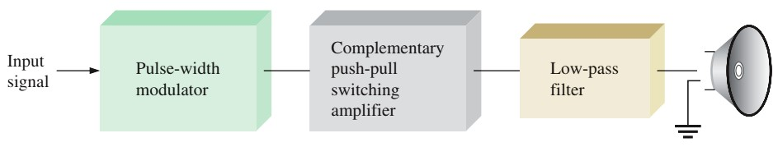
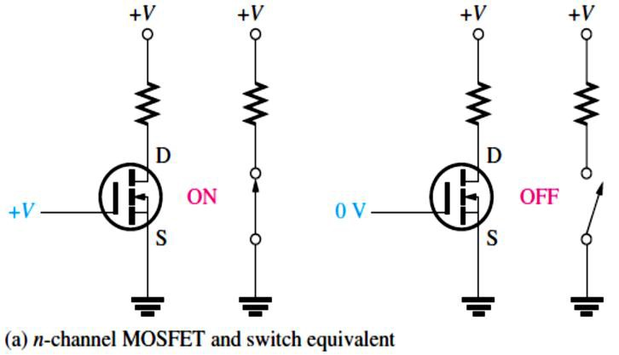
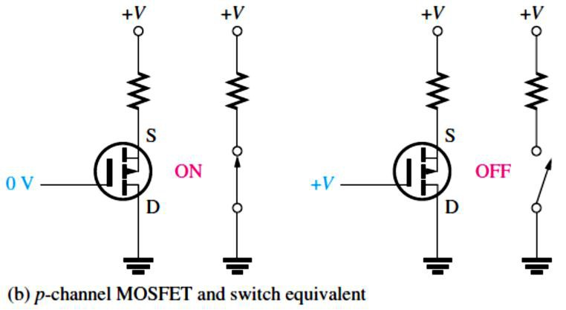
9.4 The Class D Amplifier
The class D amplifier is a nonlinear amplifier because its transistors are switched on and off (i.e, Its transistors are operated as switches) in response to an analog input instead of operating linearly over a continuous range of input values as in the classes A, B, and AB.
The class D amplifier primarily uses only MOSFETs.
A basic block diagram of a class D amplifier driving a speaker is shown in Figure 9-20.
  The class D amplifier uses pulse-width modulation (PWM) to represent the input signal.
  A low-pass filter converts the PWM signal back to the original input signal.
�𝑜�� �𝑜��
The efficiency of a class D amplifier approaches 100%. 𝜂_{�𝑎𝑥}= � = �
+�
= 1
�𝑜�
𝑜�� 𝐷�
FIGURE 9-20:
Basic class D audio amplifier.
EXAMPLE 9-12: A certain class D amplifier dissipates an internal power of 100 mW in the comparator, triangular-wave generator, and filter combined. Each MOSFET in the complementary stage has a voltage of 0.4 V across it in the on state. The amplifier operates from
±15 V dc sources and provides 0.5 A to the load. Neglecting any voltage dropped across the filter, determine the output power and the overall efficiency.
Solution The output power to the load is ���� = (�_{DD} − �� )𝐼_{𝐿}= (15 V − 0.4 V)(0.5 A) = 7.3 W
�_{���(𝑖��)} = �_{𝐷�} + �_{𝑖��} = (0.4 V)(0.5 A) + 100 mW = 200 mW + 100 mW = 300 mW
The efficiency is 𝜂= ���� ⁄(���� + �_{���(𝑖��)}) = 7.3 W⁄(7.3 W + 300 mW) = 0.961
9.5 MOSFET Analog Switching
E-MOSFETs are generally used for switching applications because of their threshold characteristic, �_{GS(th)}.
When the �_{GS} < �_{GS(th)}, the MOSFET is off (open switch). When the �_{GS} > �_{GS(th)}, the MOSFET is on (closed switch) as shown in Figure 9-21.
FIGURE 9-21: The MOSFET
as a switch.
10

Slide 11
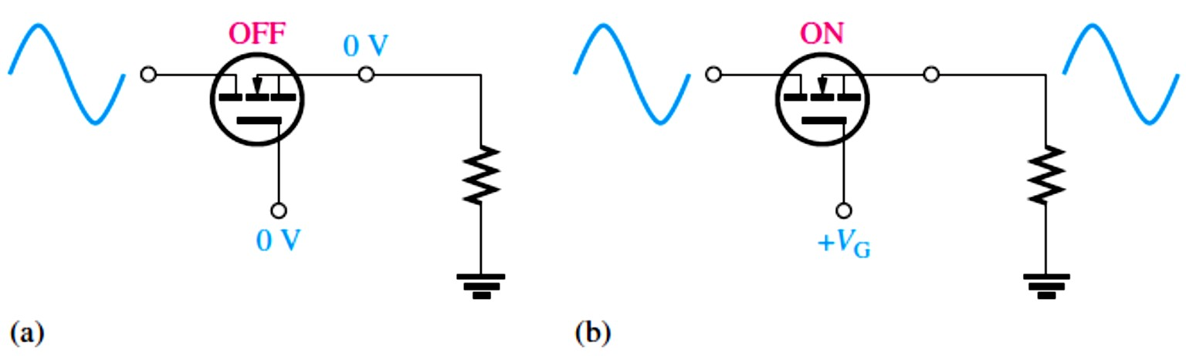
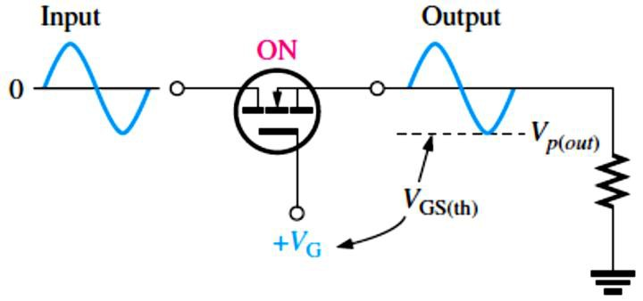
The Analog Switch: MOSFETs are commonly used for switching analog signals. An analog switch passes or blocks an analog signal when turned on or off by a digital control input.
A basic n-channel MOSFET analog switch is shown in Figure 9-22.
The �_{GS} must be equal to or greater than �_{GS(th)} to keep the MOSFET in conduction as shown
in Figure 9-23.
�GS ^{= �}G ^{− �}�(���) ≥ �GS(th)
FIGURE 9-22: Operation of an
n-channel MOSFET analog switch.
FIGURE 9-23: Input Output Signal amplitude is limited by �_{GS(th)}.
EXAMPLE 9-13: A certain analog switch similar to the one shown in Figure 9-23 uses an n- channel MOSFET with �_{GS(th)} = 2 V. A voltage of +5 V is applied at the gate to turn the switch on. Determine the maximum peak-to-peak input signal that can be applied, assuming no voltage drop across the switch.
Solution The difference between the gate voltage and the negative peak of the signal voltage must equal or exceed the threshold voltage. For maximum �_{�(���)},
�G ^{− �}�(���) ^{= �}GS(th),
�_{�(���)} = �_{G} − �_{GS(th)} = 5 V − 2 V = 3 V
�_{pp(𝑖�)} = 2�_{�(���)} = 2(3 V) = 6 V
Analog Switch Applications: One application of analog switches is in analog-to-digital conversion (ADC).
The analog switch is used in a sample-and-hold circuit to sample the input signal at a certain rate.
A sampling circuit is an analog switch that is turned on for short time intervals to allow a sufficient number of discrete input signal values to appear on the output so that the input signal can be accurately represented by those discrete values as is illustrated in Figure 9-24.
The minimum sampling frequency is called the Nyquist frequency.
��𝐚����(���) > ������𝐚�(�𝐚𝐱)

Slide 12
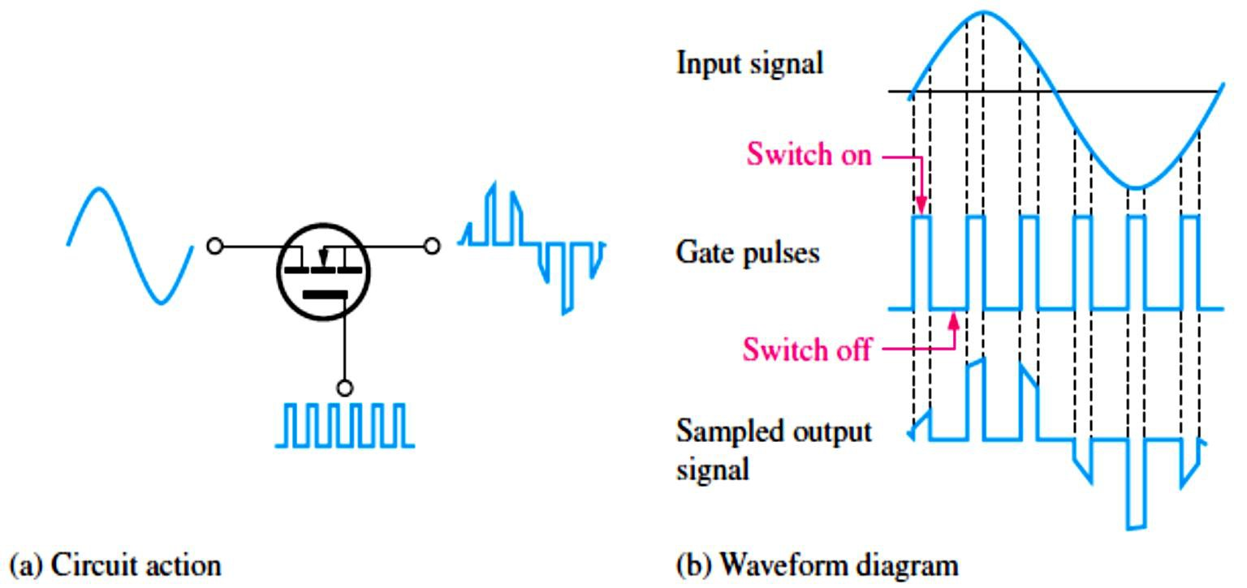
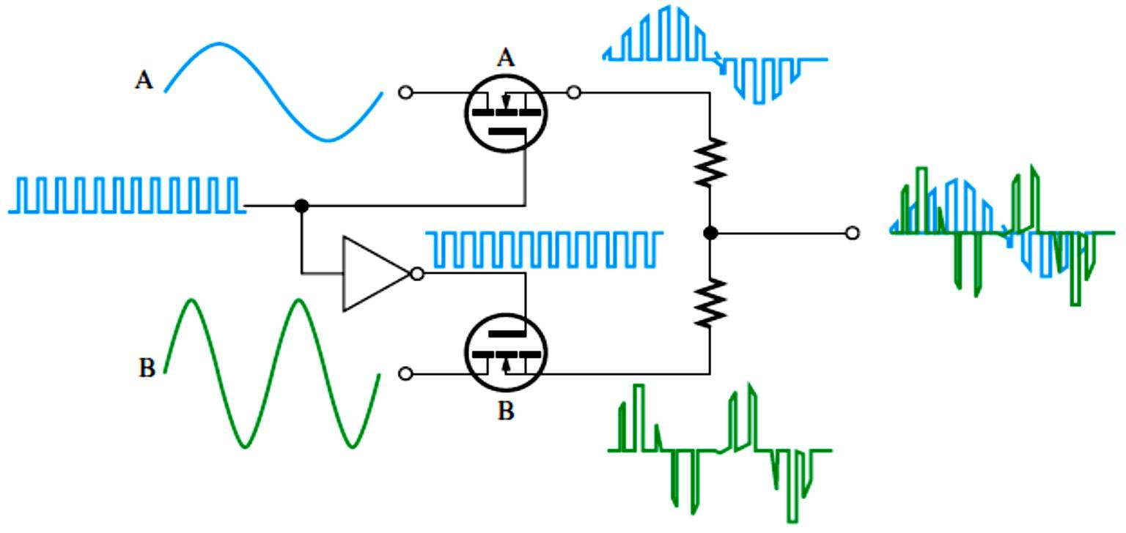
FIGURE 9-24: The
analog switch operating as a sampling circuit.
EXAMPLE 9-14: An analog switch is used to sample an audio signal with a maximum frequency of 8 kHz. Determine the minimum frequency of the pulses applied to the MOSFET gate.
Solution
�sample(min) ^{> 2�}signal(max) ^{= 2�}signal(max) ^{= 2(8 kHz) = 16 kHz}
The sampling frequency must be greater than 16 kHz.
Analog Multiplexer: Analog multiplexers are used where two or more signals are to be routed to the same destination. For example, a two-channel analog sampling multiplexer is shown in Figure 9-25. The MOSFETs are alternately turned on and off so that first one signal sample is connected to the output and then the other.
FIGURE 9-25: The analog multiplexer is alternately sampling two signals and interleaving them on a single
output line.
Switched-Capacitor Circuit: Another application of MOSFETs is in switched-capacitor circuits commonly used in IC programmable analog devices known as analog signal processors.
A switched-capacitor can be used to emulate a resistor as shown in Figure 9-26 using a
mechanical switch analogy (MOSFETs are actually used as the switches) in programmable IC

Slide 13
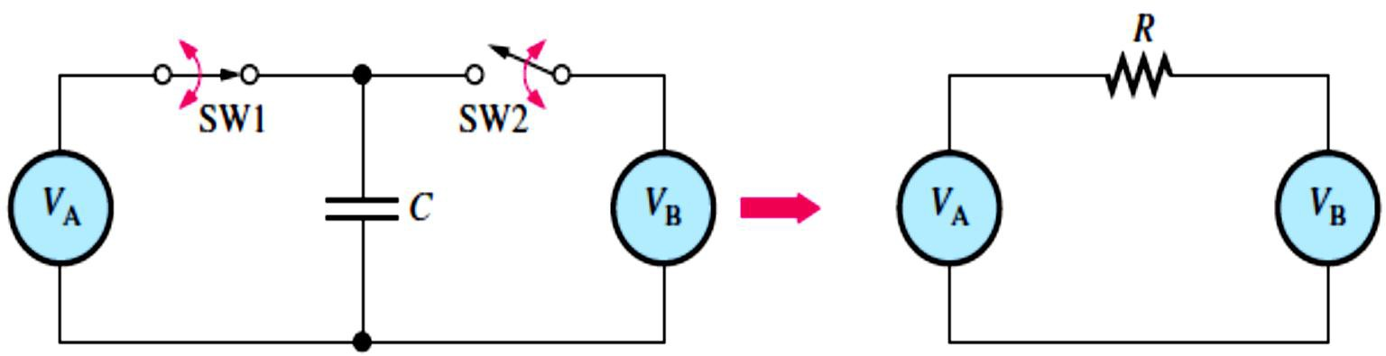
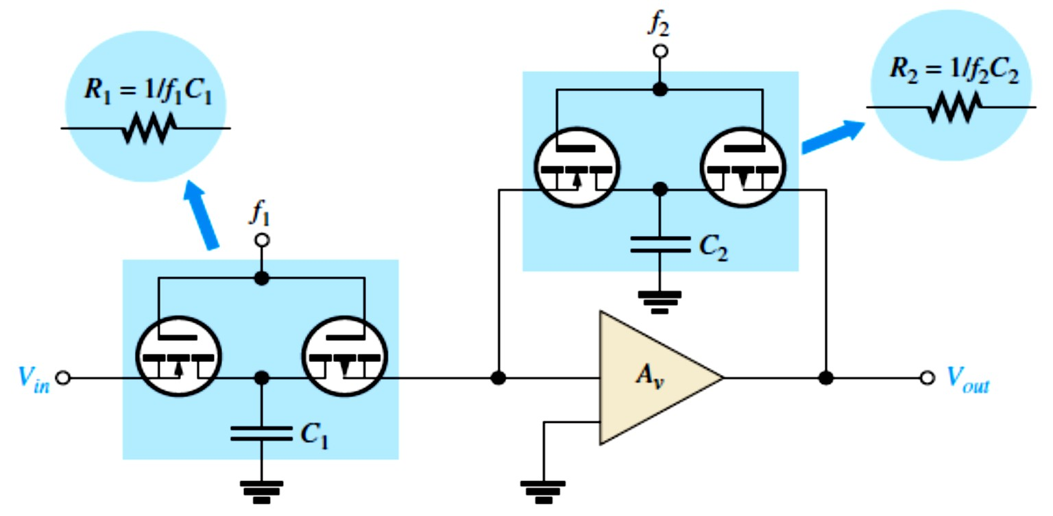
analog arrays. Capacitors also take up less space on a chip than an IC resistor and dissipate no power.
Switch 1 and switch 2 are alternately turned on and off at a certain frequency to charge or discharge 𝐶, depending on the values of the voltage sources.
It can be shown that the capacitor emulates a resistance with a value that depends on the
frequency at which the switches are turned on and off and the capacitance value.
𝑹= �⁄(��) Equation 9– 10
FIGURE 9-26: A switched capacitor emulates a resistance.
Complementary E-MOSFETs and capacitors can be used to replace the resistors in the amplifier, as shown in Figure 9-27.
  When �₁ is on, �₂ is off and vice versa. The frequency �₁ and �₁ are selected to provide the required value of �₁. Likewise, �₂ and 𝐶₂ provide the required value of �₂. To reprogram the amplifier for a different gain, the frequencies are changed.
FIGURE 9-27: The IC amplifier in with switched-capacitor circuits replacing the resistors.
9.6 MOSFET Digital Switching
MOSFETs are also used in switching applications in digital ICs and in power control circuits.
MOSFETs used in digital ICs are low-power types, and those used in power control are high- power devices.
CMOS (Complementary MOS): combines n-channel and p-channel E-MOSFETs in a series as shown in Figure 9-28.

Slide 14
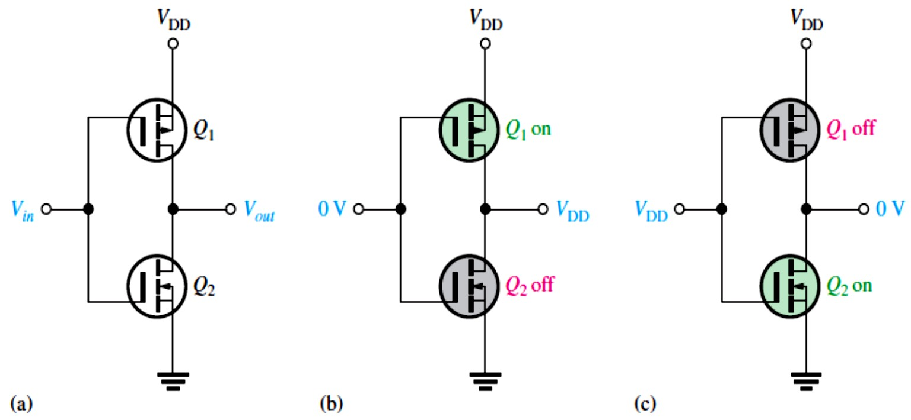
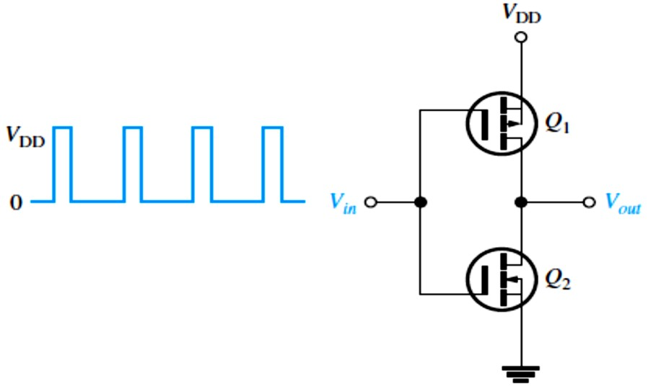
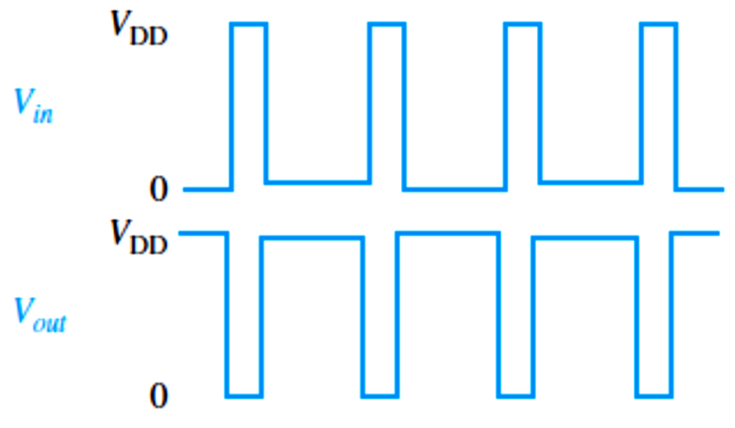
When �_{𝑖�} = 0 V, �₁ is on and �₂ is off. Because �₁ is acting as a closed switch, the output is approximately �_{DD}. When �_{𝑖�} = �_{DD}, �₂ is on and �₁ is off. Because �₂ is acting as a closed switch, the output is essentially connected to ground (0 V).
The inverter, NAND gate, and NOR gate are examples of digital logic circuits
FIGURE 9-28: CMOS inverter operation.
EXAMPLE 9-15: A pulse waveform is applied to a CMOS inverter as shown in Figure 9-29. Determine the output waveform and explain the operation.
FIGURE 9-29
Solution The output waveform is shown in Figure 9-30 in relation to the input. When the input pulse is at �_{DD}, �₁ is off and �₂ is on, connecting the output to ground (0 V). When the input pulse is at 0, �₁ is on and �₂ is off, connecting the output to �_{DD}.
FIGURE 9-30

